Slide 1
Rasterization
Computer Graphics Introduction
Summer 2020

Slide 2
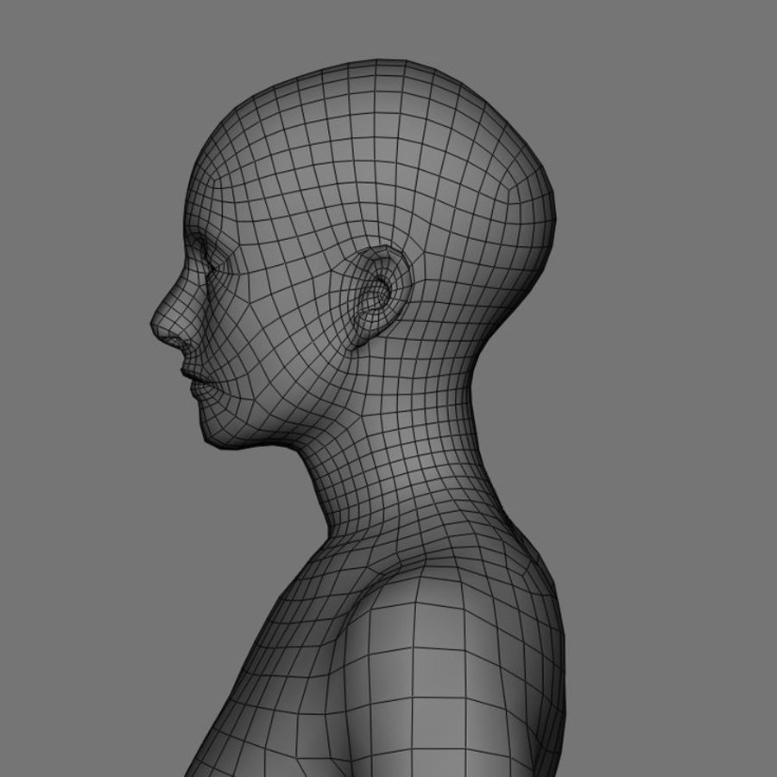
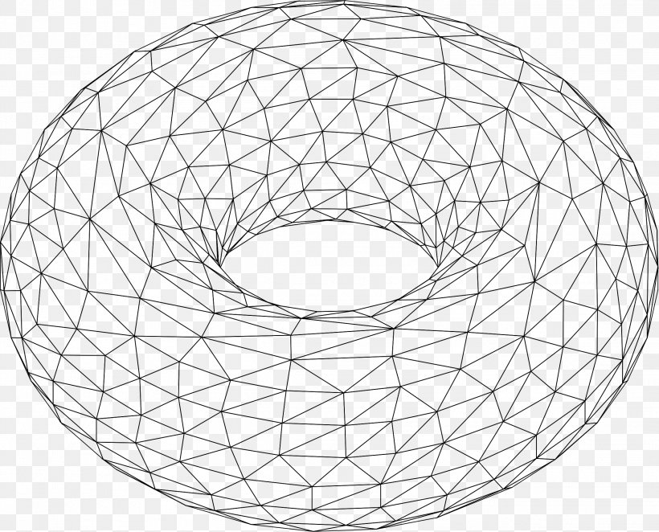
The Graphics Pipeline, So Far
Modelling of Objects using Geometric Primitives Traditionally done using triangles, we make a wire frame for an object.

Slide 3
The Graphics Pipeline, So Far
2. Giving Models their “World Coordinates” Transforming the local coordinate system for each model into their relative 3D world coordinate system.
3. Transforming Coordinates according to what the camera is seeing Transforming the 3D world coordinate system into the 3D camera coordinate system, with (usually) the camera as the origin.
4. Transforming 3D Camera Coordinates to the 2D image that falls on the lens 3D camera coordinates convert to a 2D plane, called the “Viewport”. Depends on orientation of camera, shape of its frustum etc.

Slide 4
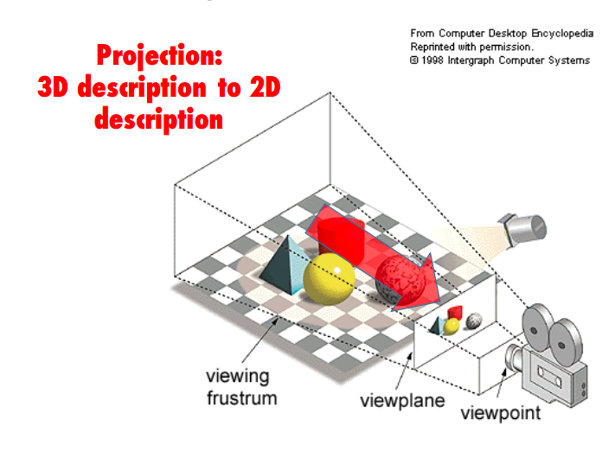
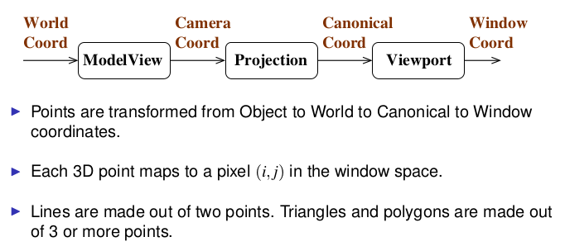
The Graphics Pipeline, So Far

Slide 5
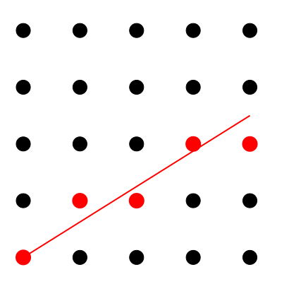
What’s Next?
Rasterization Simply put, Rasterization is the process of taking a primitive and figuring out which pixels it covers.
It’s also often called scan conversion. Primitives have to be mapped to the right pixels. Simple raster operations can be as trivial as just setting pixel values or not (binary decision). Once the pixel is decided, it needs to be given a colour, depth and a texture. More complex operations come after this - like compositing and anti-aliasing. Line width is usually fixed at 1 pixel.

Slide 6
What’s Next?
While the task of deciding which pixels light up for specific primitives might appear trivial, doing so in an efficient manner required lots of research and specialised algorithms. Various methods of interpolation and aliasing have been tried over the years, and small changes in how pixels are chosen introduce big changes in how lighting and texture is calculated. When you have multiple primitives on a single pixel, we also have to keep track of the closest primitive (z-buffer), and only overwrite if triangle being drawn is closer than the previous triangle in that pixel.

Slide 7
What’s Next?
What Primitives?
Primitives
Line Segments
Triangles
That’s all! What about curves? Those can be aliased and approximated using small line segments. Polygons? Keep breaking them into smaller triangles. And Curved surfaces? Again, approximate them with triangles. The trend over the past few decades has been to minimise primitives, because operations that are simple, uniform, and repetitive are very easy to parallelise.

Slide 8
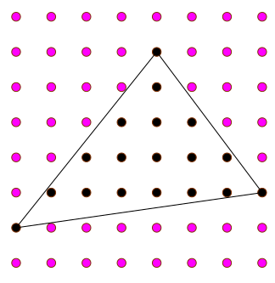
Rasterizing Primitives
Lines
Triangles

Slide 9
Desirable Properties while Rasterizing
Primitives have to be mapped to the right pixels. There’s a few key requirements for a task like this.
No gaps in adjacent pixels
Pixels close to ideal line
Consistent choices; same pixels in the same situations
Smooth looking
Work the same in all orientations
Same line drawn for P0->P1 and P1->P0

Slide 10
Line Clipping
Actually, even before we figure out how to display a pixel on the screen, we must identify what pixels are actually relevant. Almost always, you’re going to have lines that have one or both endpoints of the line outside your field of view. Obviously, we’d only like to draw that part of the line that’s actually visible. Your world lines are almost never going to align nicely onto points inside the window.

Slide 11
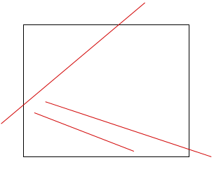
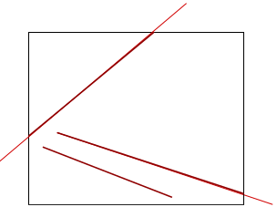
Line Clipping
Actually, even before we figure out how to display a pixel on the screen, we must identify what pixels are actually relevant. Almost always, you’re going to have lines that have one or both endpoints of the line outside your field of view. Obviously, we’d only like to draw that part of the line that’s actually visible. Your world lines are almost never going to align nicely onto points inside the window.

Slide 12
Line Clipping
Clipping It just means finding the part of the line that lies INSIDE the window.
Actually, even before we figure out how to display a pixel on the screen, we must identify what pixels are actually relevant. Almost always, you’re going to have lines that have one or both endpoints of the line outside your field of view. Obviously, we’d only like to draw that part of the line that’s actually visible. Your world lines are almost never going to align nicely onto points inside the window.

Slide 13
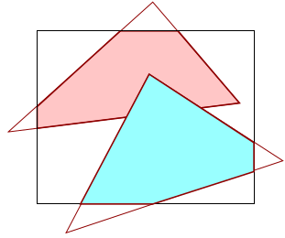
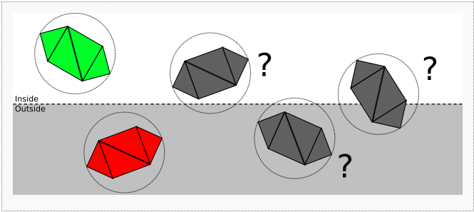
Triangle Clipping
Bounding Boxes are often used as a precalculation step. Finally, the equation of the plane and the equation of the triangle is used to draw planes within the triangle, and these planes are the either clipped or drawn.
Only parts of the triangle may lie in the window.
You can either have the entire triangle inside the view frame or outside, or one vertice inside, or two vertices inside (requiring you to draw two triangles again).
First clip a triangle to a (planar!) polygon, that lies inside.
Scan convert the polygon subsequently.
Sutherland–Hodgman algorithm

Slide 14

More on Clipping
Can we do better? What if we decided to do both clipping and scan conversion normally? This is called scissoring. We can think of the frame buffer as an infinite canvas, of which a small rectangular portion is sent to the screen. The simplest way to do this is define our clipping rectangle, (x₁, y₁) to (x₂, y₂), and then check whether each pixel lies in this, and scan convert normally.

Slide 15
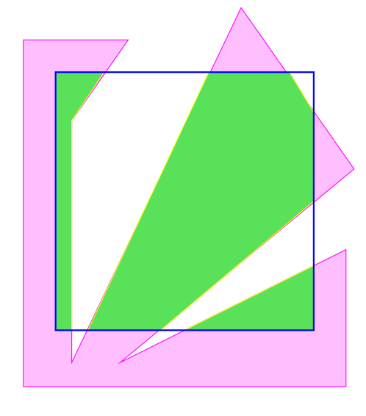
More on Clipping Polygons
The problems with clipping polygons is that depending on their orientation. The can transform into wildly different shapes upon being clipped normally. Convex polygons remain convex after clipping, but concave polygons can be clipped to multiple smaller polygons.

Slide 16
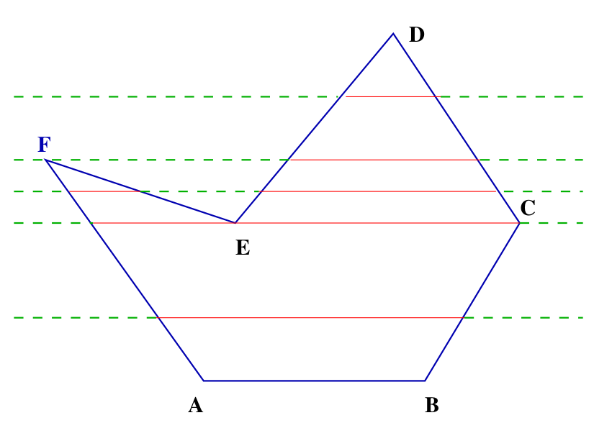
More on Clipping Polygons
There are several ways of efficiently clipping polygons, a lot of which we won’t be able to cover today. But for an overview, let’s talk about a common way that has been often used in the past.
We make use of specialised data structures for this task. We define edges in something called as an edge bucket.
We create an ‘Edge List’, which is a list of edge buckets, sorted by Y_{min} . The idea is to scan polygons via a line by line method. Once we initialise a Y_{min} (equal to our clipping box’s Y_{min}), we add these edges to an active list, which is sorted by X_{min}.

Slide 17
Linear Interpolation of Properties
We know that every pixel will need a colour, depth and texture. If we make certain assumptions about how these properties play out in real life, we can potentially save lots of computation.
One such assumption that we safely make is that These properties vary linearly across the plane. It’s important to save on the recalculations, because calculating lighting, depth and texture for each pixel is magnitudes of orders more expensive that approximating them.

Slide 18

Properties vary linearly across a plane
If we know the colour, texture coordinate, and depth at the vertices of the polygon or line, these can be interpolated to pixels on the inside of the plane linearly! We can use this to reduce computation by computing colors only at vertices, or light normals at vertices, or specific texture coordinates. For example, computed diffuse color of a hair being drawn using lines (only at vertices)
Interpolation Interpolation can be described as the mathematical procedure applied in order to derive value in between two points having a prescribed value. Here’s a simple interpolation linear equation.

Slide 19
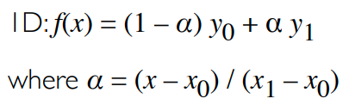
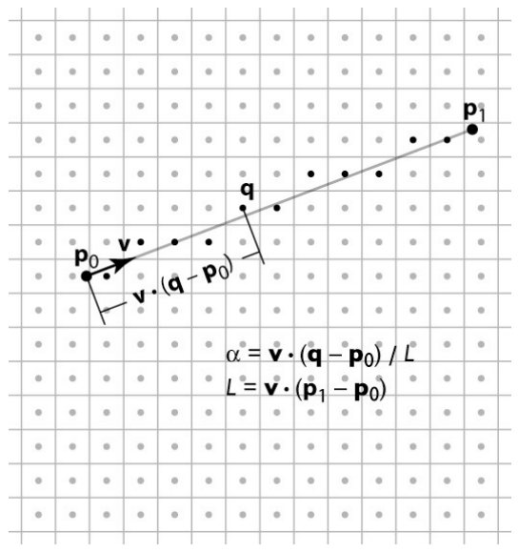
Linear Interpolation Continued
In the 2D case of a line segment, alpha is just the fraction of the distance from (x0, y0) to (x1, y1).
Basic Definition
We observe pixels will not lie on the ideal line. We will have to define a 2D function by projection on line. There’s various 2D interpolation algorithms out there, but we’ll look at what’s called a Digital differential analyzer, which is just a simple quadratic interpolation equation. The advantage is that we’ll be able to convert this into a simpler coordinate system, easing our understanding and reducing computations.

Slide 20
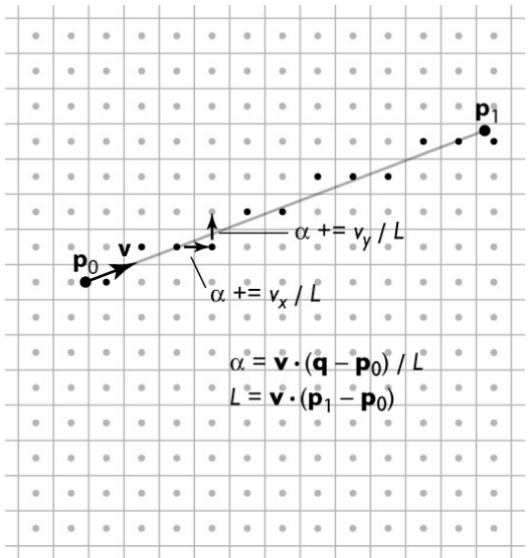
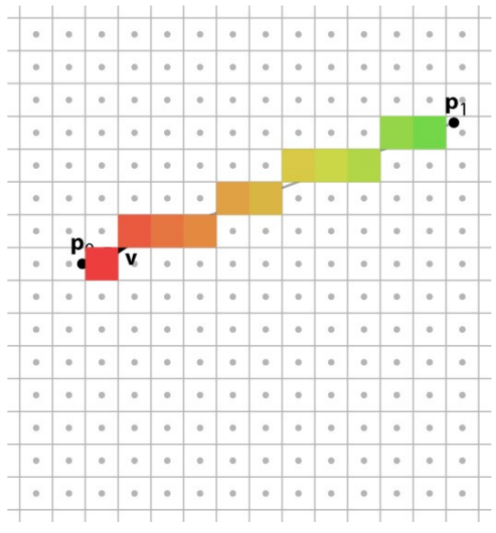
What we’re trying to do

Slide 21
Linear Interpolation Continued
At the risk of over simplifying things, essentially as we go up a diagonal line, we need to keep track of two variables - d, which describes how far from the line we are, and ɑ, which tells us how far along the line we are. So d and α are coordinates in a coordinate system oriented to the line. d is the vertical distance from the line. ɑ is the horizontal distance from the line.

Slide 22
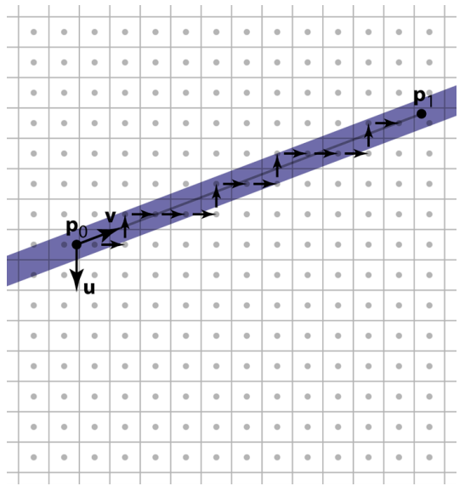
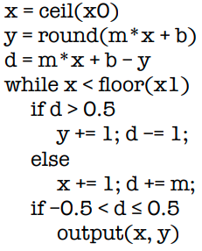
Linear Interpolation Continued
It’ll help if we visualise our loop as visiting all pixels the line passes through.
Interpolate d and α for each pixel
Only select it if pixel is in band (of the line)
This makes linear interpolation the primary operation.

Slide 23
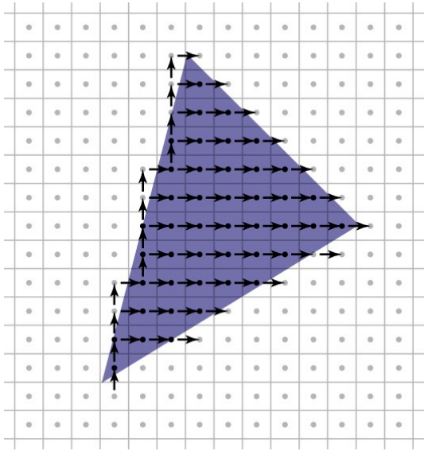
Linear Interpolation for Triangles
Doing interpolation for triangles is extremely similar.
Conservatively visit a superset of the pixels you want
Interpolate using the same linear functions
Use those functions to determine when to emit a fragment

Slide 24

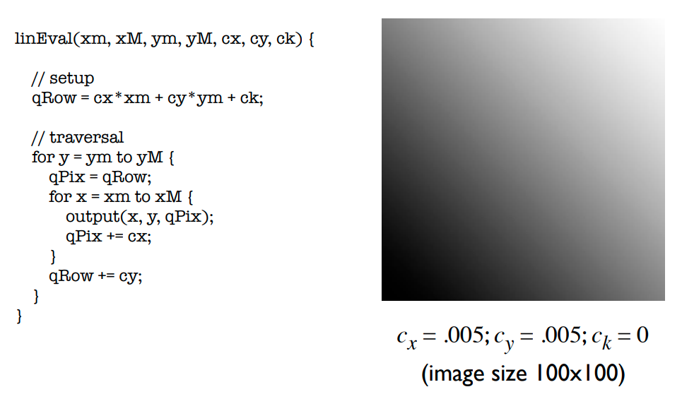
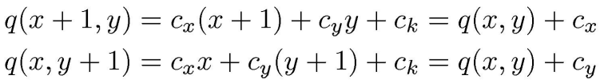
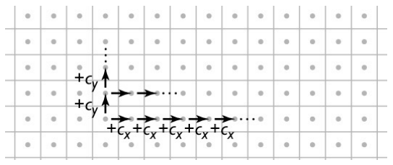
Interpolating Several Parameters (Continued)
We can use the same intuition to estimate several other parameters pertaining to polygon interpolation.
A simple linear function
Linear functions are efficient to evaluate on a grid

Slide 25
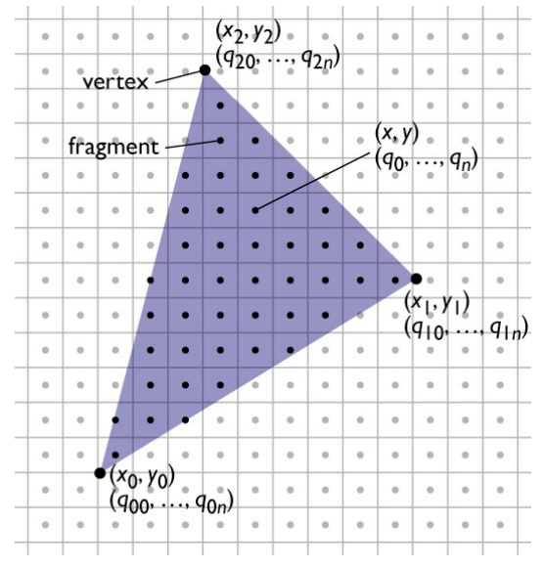
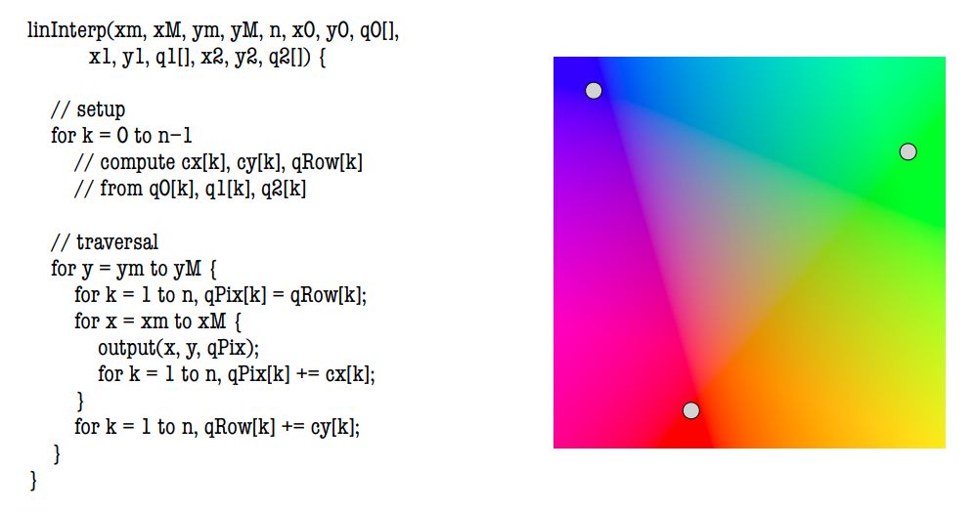
Interpolating Several Parameters
We can use the same intuition to estimate several other parameters pertaining to polygon interpolation. Things like colour, texture etc. Simpler interpolation methods are quicker, and more complex methods yield higher results.
Interpolation can do so much for digital media. Upscaling video to higher resolution, increasing video frame rates, making smooth slow motion video. Lately, machine learning based interpolation is booming, and is providing unprecedented, high quality results.

Slide 26
How can we optimise its efficiency?
Optimisation is the name of the game here. A single cache miss can make an operation worth half a clock cycle, take about 400-600 clock cycles. While this isn’t as bad for general consumer applications, games and graphical responsive applications simply cannot afford this. What we’ve done so far is use a simple algorithm, that’s easy to implement. But we’re employing a lot of floating point calculations, and while modern processors have dedicated floating point arithmetic hardware, this wasn’t always the case. Let’s see how we convert our code to an integer friendly code.

Slide 27
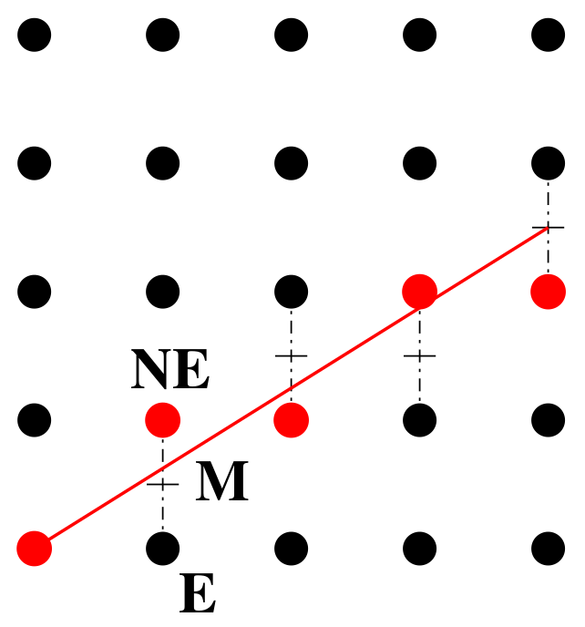
How can we optimise its efficiency?
There are multiple integer arithmetic based algorithms, like the mid point algorithm and Bresenham’s algorithm. Essentially, what we exploit, is that at each step, we have two options, either move up or move left. (North East, or East)

Slide 28
The Mid Point Line Algorithm
Line equation: ax + by + c = 0, a > 0. Let 0 < slope = ∆y/∆x = −a/b < 1.0
F(x, y) = ax + by + c > 0 for above the line, < 0 for below.
If F(Mid Point) > 0, pick NE, else pick E
d_{E} = F(M) = d + a, d_{NE} = F(M) = d + a + b
Therefore, ∆_{E} = a, and ∆_{NE} = a + b
Initial value: d₀ = F(x₁ + 1, y₁ + 0.5 ) = (a + b) /2 Similar analysis for other slopes. Eight cases in total.

Slide 29
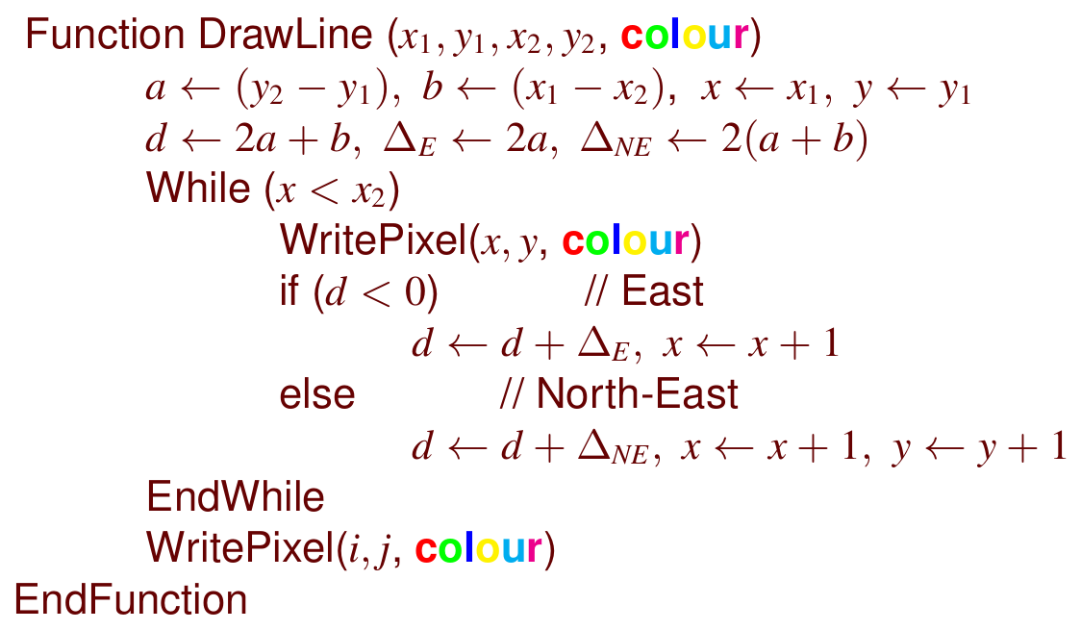
The Mid Point Line Algorithm Pseudocode

Slide 30

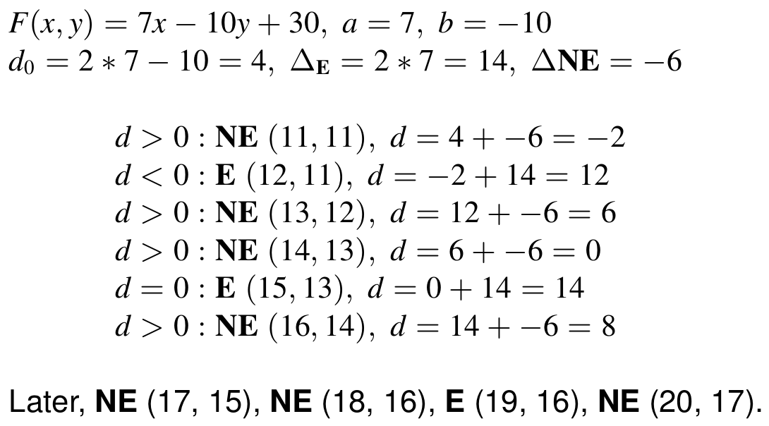
The Mid Point Line Algorithm Example

Slide 31
Shared Points/Edges
As scenes get more complex, it gets common to have intersecting lines (points common between two lines and edges between two polygons). Keep in mind that this is not the same as lines and primitives that would appear to be on top of each other; we took care of that using our z index. These points would be scan converted multiple times. This is not efficient, and can sometimes be harmful, depending on order of rasterization. To combat both of these issues at the same time, an ingenious solution of treating line intervals as closed on the left and open on the right.

Slide 32
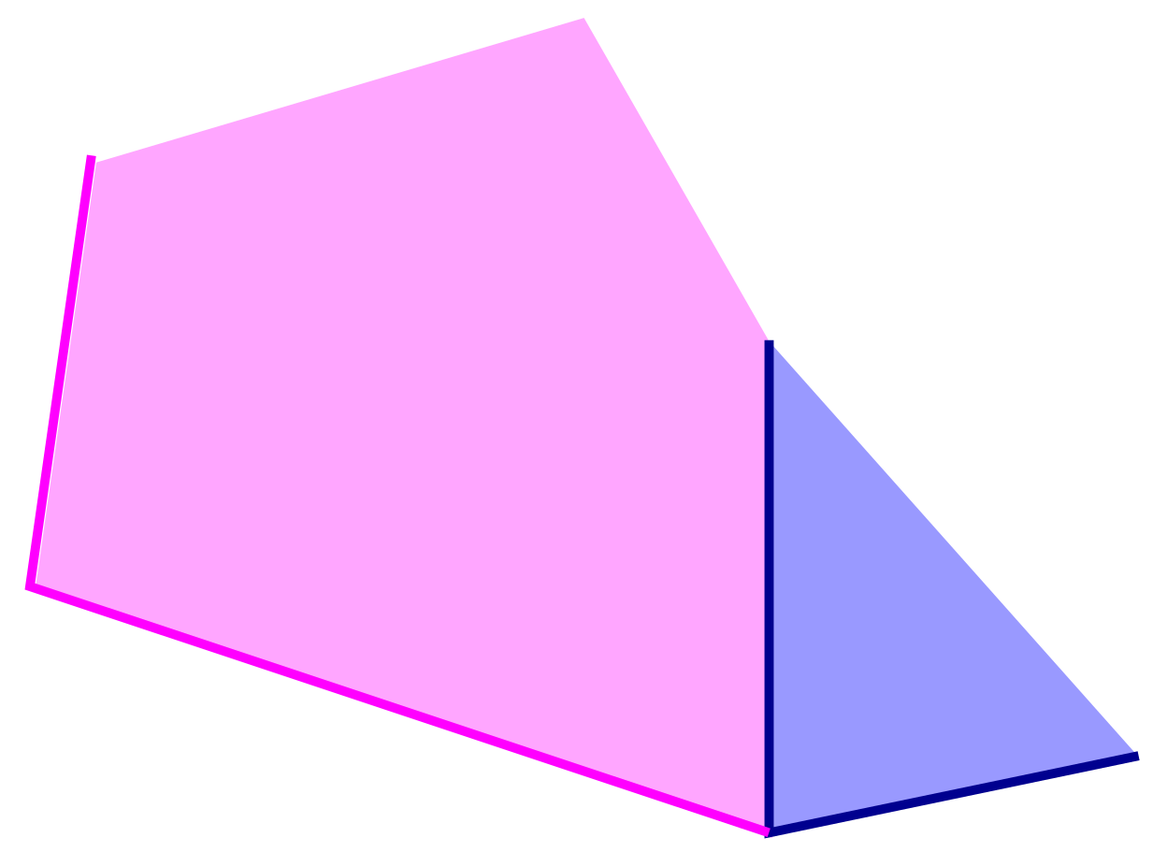
Shared Points/Edges
This essentially means, not considering the edges of polygons on the top and right borders.

Slide 33
Advantages of Rasterization
Modern scenes are more complicated than images Not really an advantage, but a necessity. Our scenes have gotten so complex over the years that they do not fit in a fixed window (unlike simple 2D games). This wasn’t always true.
A rasterization-based renderer can stream over the triangles, no need to keep entire dataset around. Optimisations enable us to reuse much of the rasterization calculations again and again on small frame changes. This allows for a lot of parallelism and optimization of memory systems.

Slide 34
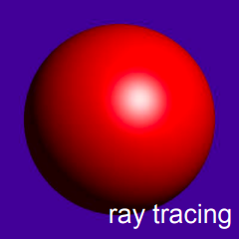
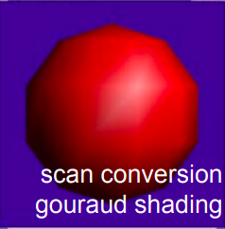
Limitations of Rasterization
Restricted to scan-convertible primitives Much of the work done here is restricted to triangle scan conversion.
Faceting, shading artifacts Less prevalent today with per pixel shading capabilities of modern GPUs, but as a lot of rasterization optimisation revolved around making good approximations, it inevitably led to artifacting in scene rendering.
No unified handling of shadows, reflections, transparency
Potential problem of overdraw (high depth complexity) Each pixel touched many times

Slide 35
Finally, it is over.
Thank you!

Slide 36
Useful References
Spring 2019’s Graphics Course Slides on Rasterization https://drive.google.com/file/d/10DOnwAI1Z2hVdtWS2w6FAGj9kZOVg-NH/view?usp=sharing
MIT OpenCourseWare Lecture on Graphics Pipeline and Rasterisation https://ocw.mit.edu/courses/electrical-engineering-and-computer-science/6-837-computer-graphics-fall-2012/lecture-notes/MIT6_837F12_Lec21.pdf
Cornell CS4620 Lecture 12 on Rasterization http://www.cs.cornell.edu/courses/cs4620/2017sp/slides/12rasterization.pdf
Leland Stanford Junior University - Introduction of Graphics and Imaging https://mdzahidh.github.io/cs148/assets/slides/03-Rasterization.pdf
Worcester Polytechnic Institute http://web.cs.wpi.edu/~emmanuel/courses/cs4731/archives/A03/slides/lecture20.pdf

